Slide 1

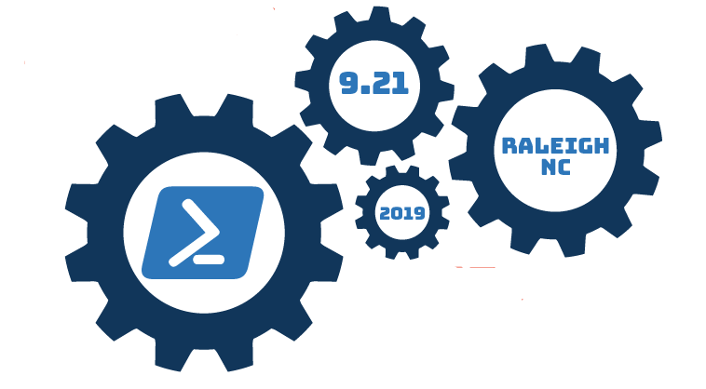
File Filtering at Scale
Performance Analysis of I/O-bound problems in Powershell environments

Slide 2





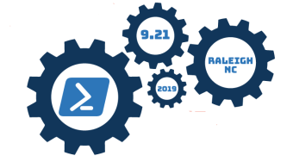
Thank you to our sponsors

Slide 3
About Me
Systems programmer in the 1980s
Software instructor in the early-mid 1990s
IT consultant since the mid-90s
Frequent conference and meetup presenter
Started/lead/supported local user groups, conferences, & meetups
Notes:
The TL;DR:
This isn't premature grey…it's immature grey ☺

Slide 4

I/O...I/O...It's oft too slow I go.
It matters not how fast my clock, I/O...I/O.
Notes:
Bonus points if you can identify the actors and the play.

Slide 5
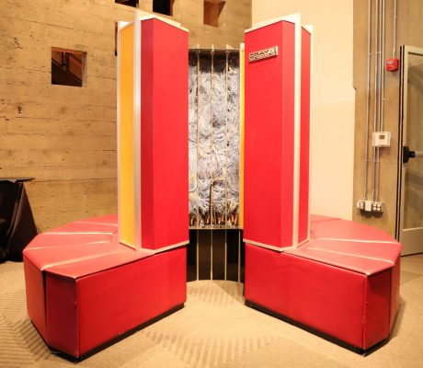
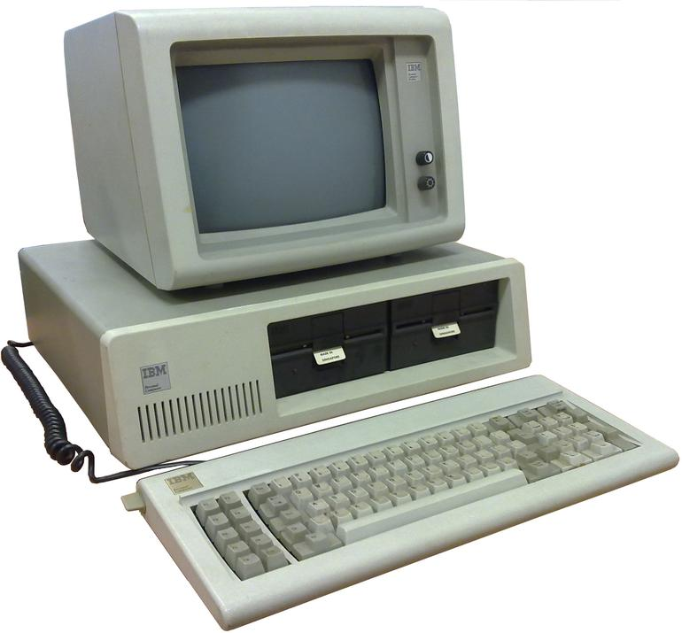
All computers wait at the same speed

Slide 6

I/O is EVERYWHERE
Disk I/O
OS I/O
PS pipeline I/O
Network I/O
Screen I/O

Slide 7
The Problem
Phil Bossman's problem
Part of an audit by Toad Software
Toad sent Phil the file name filter list
Phil needed to apply that filter to the C: drives on all computers on his network
Inherent Requirement for tracking the audit work.
Note: Phil couldn't use remoting, only the Admin share ☹
Notes:
Phil used Invoke-Parallel to invoke the searches on 10 computers at a time.
Did it complete?
Did it look at all the entire directory tree?
Show Phil's vendor's file filters PSSaturdayDemo1.ps1 (in the ISE)
Show my file filters (in Notepad++) New User_20190917_074501.note

Slide 8
This Problem - Been There, Done That
When directory sizes grow, it is difficult to enumerate the files in a timely manner
Filtering files is a slow process wrapped in enumeration & iteration
I've faced this problem in a variety of Windows environments (VBScript, VBA/VB classic, Python, Powershell)
It's a good problem, faced by many
It involves three things I like: Performance Analysis, Powershell, and Regular Expressions
Notes:
TL;DR – This file filtering problem is useful to illustrate the performance analysis theme of this presentation

Slide 9
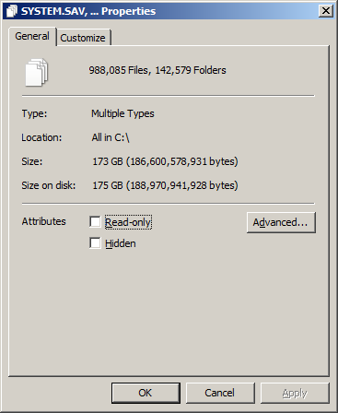
Scope of the example on my laptop
Notes:
988K+ files
142K+ folders
* Explorer C: properties time: 14-20 mins
* Spinning hard drive – a plus for measurement
Why not use Explorer?
* Explorer dialog doesn't filter well
* Explorer can only filter one pattern at a time
* A very manual process - not applicable for automation

Slide 10
Algorithmic Configurations
Monolithic view of C:\
Parallel view of the C:\ sub-trees
Tree Trimming
Going around the problem
Hybrid approaches
When is our 'solution' fast enough?
Notes:
Tree Trimming manually or programmatically. Phil limited his search to 500 computers.
I am limiting our solution to the tools at hand

Slide 11
Approaches - Possible Solutions
Don't do it
Do it only by exception/request
Statistical sampling of the population
Minimize what you have to process
Bypass I/O parts of the solution
Do the I/O more efficiently - software or hardware
Do the filtering efficiently or in parallel
Magic
Notes:
Show New User_20190916_144028.note

Slide 12
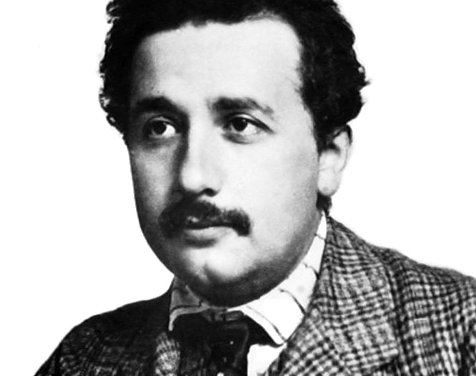
What do we measure?
Time
Space
Maybe I/O ops
Notes:
If I/O rate is limited (garden hose), the CPU usage for filtering will be low. Conversely, CPU can rise if the filtering operation(s) have a lot to do (fire hose).
You could wind up like Lucy and Ethyl on the candy line. ☺

Slide 13
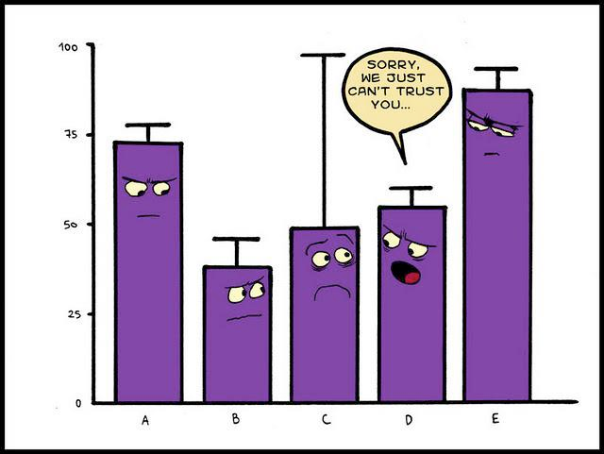
Stats .101
Take Multiple Samples
Use Median
Include both Time and Space data
Notes:
Ideally 20-30 samples
Realistically 5-11 samples
No need for fancy stats and charts

Slide 14

How to measure
Time spans
Measure-Command{ }
$start = Get-Date; $end = Get-Date; ($end - $start).totalminutes
Process stats
Get-Process –id $pid | select ws, PeakWorkingSet
$p = start-process –passthru
Task Manager
Notes:
It is good to look at the Task Manager when you are developing your tests and evaluating different methods.

Slide 15
When to measure
AFTER YOU ARE SURE THE CODE WORKS AS INTENDED!!

Slide 16
Obstacles to Performance Measurement
Ordinary and necessary programs
Windows processes
User applications, such as Chrome
System Caching
PS script JIT Compiling
Memory footprint
Safe mode
Notes:
Ordinary and necessary programs, like anti-virus and database
Windows processes (do I need this svchost?), like Windows Update.
Caching - first runs are always slower
PS script JIT Compiling - first runs are always slower
At some point you might enter a paging condition, which affects your entire system performance.
boot up in Safe mode - can't test everything

Slide 17
How many possible ways are there?
WMI
Get-ChildItem -recurse
.Net libraries
Hybrid configurations
Robocopy
command line DIR – NOT the GCI alias and FINDSTR
Magic
System utilities – AV or SCCM/BigFix
Notes:
This comes down to an efficiency evaluation: TIME and SPACE
Secondary to efficiency will be simplicity, ease of use, and time to create/test
Tertiary concern is system resource consumption – does this 'play well with other processes'
Robocopy runs produce great documentation. They do more I/O than expected when filtering.
Both DIR and FINDSTR have 3MB memory footprints and play well with StdOut | StdIn pipeing

Slide 18
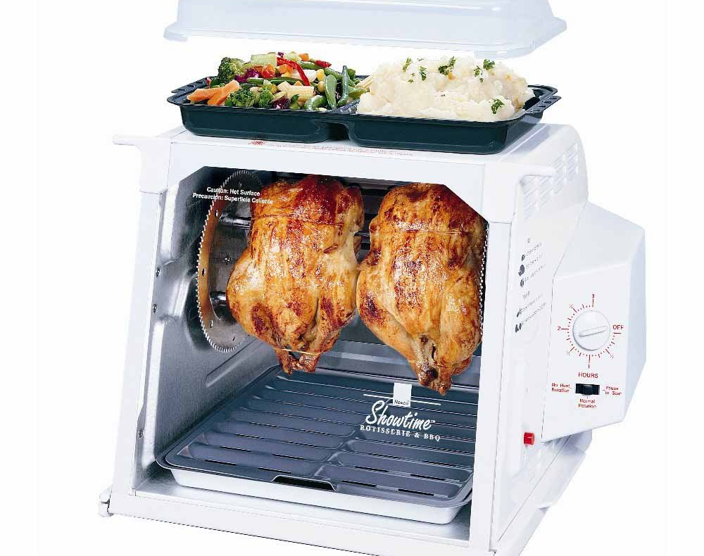
Your measuring scripts
Use launch-able scripts
Include progress indicators
Document your output metrics
Save your intermediate work
Boot up in Safe mode
Start your tests
Get some sleep
Notes:
TL;DR – only run your scripts manually until you are sure they are correct. Then invoke them and say "good night"
I'm fond of Start-job or ICM -asjob
Separates testing from launching
In case you need to visually check the progress
Don't wait until the end to output your test results
What is this device and what is its catch phrase?

Slide 19
Lessons Learned
sometimes system helping can be unhelpful
sometimes you can turn the system unhelpfulness to your advantage
we're also limited by available memory
ISE is ok for development and code testing, but do actual measurement tests in Powershell
use RAMMap or EmptyStandbyList.exe for repeatable result
Notes:
I'm looking at you, caching
Are there fast, low-cost, ways to prime the cache?
Can't get caching boost remotely ☹
Time and Space are related, but only one is bounded
ISE introduces unnecessary overhead

Slide 20
Lessons Learned
Get correct output first, then perf test
Buffering is your buddy
Beware of bottlenecks
Parallelism of tasks is fairly easy (jobs & processes & workflows) and is automatic as you distribute the work
Measuring parallelism and async tasks can be tricky
Notes:
Because we don't want to measure meaningless/useless output
We want apples-to-apples comparisons, so make sure that the output from two different tests are the same (count, format/content, hash)
One of the bottlenecks can happen because of parallelized execution competing for a single/limited resource.

Slide 21

Remember, I/O Don't Care
Notes:
Show New User_20190913_143028.note

Slide 22
Rules-of-Thumb
Minimize I/O
Streamline the pipeline
Do set processing
DRY principle
MRU lists
Modeling
You probably aren't the first one to face this problem, so look for OTS and public solutions
Notes:
If you only need a few properties, then don't push entire objects through the pipeline. Optimize the operations in the pipeline.
Set processing – think like a database person
DRY – Don't Repeat Yourself
MRU – Most Recently Used
Find a reasonable set of data to do your test development. Then test against the full-sized set of data.

Slide 23
Rules-of-Thumb
Dictionaries/hashtables > collections > arrays > databases > disk I/O > network call
.Net framework is your friend
Notes:
Skipping this slide

Slide 24
Thank You
Questions?
Mark Hutchinson
aikimark1955@gmail.com

